Slide 1


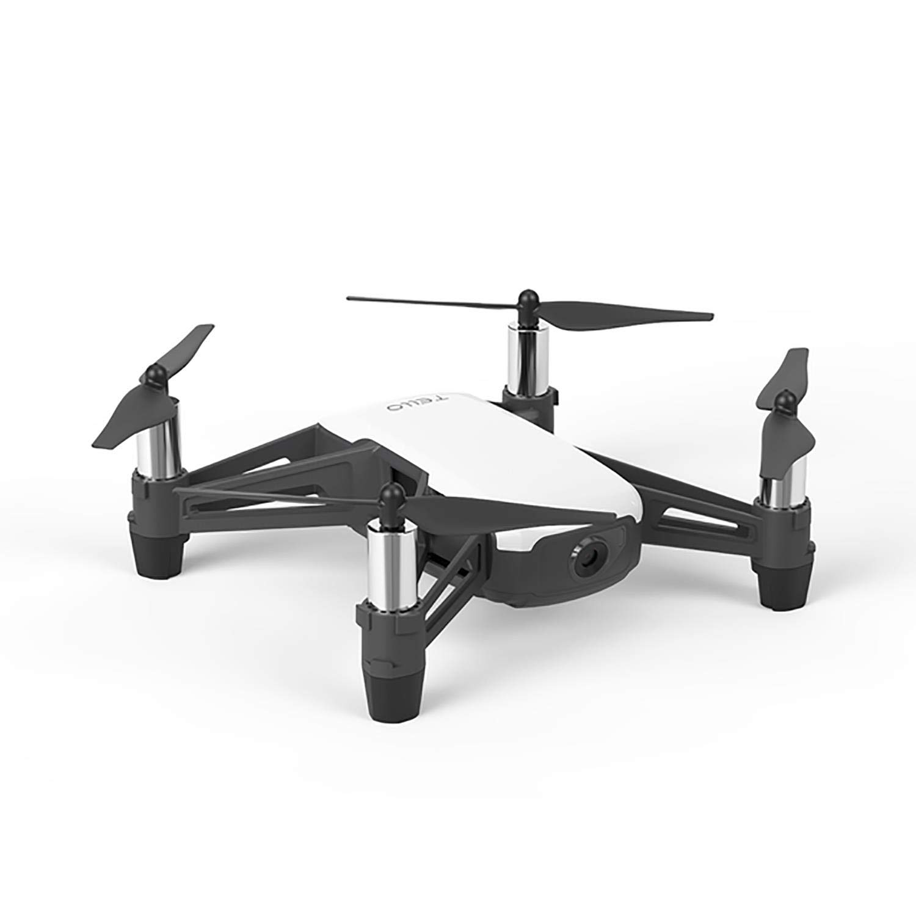
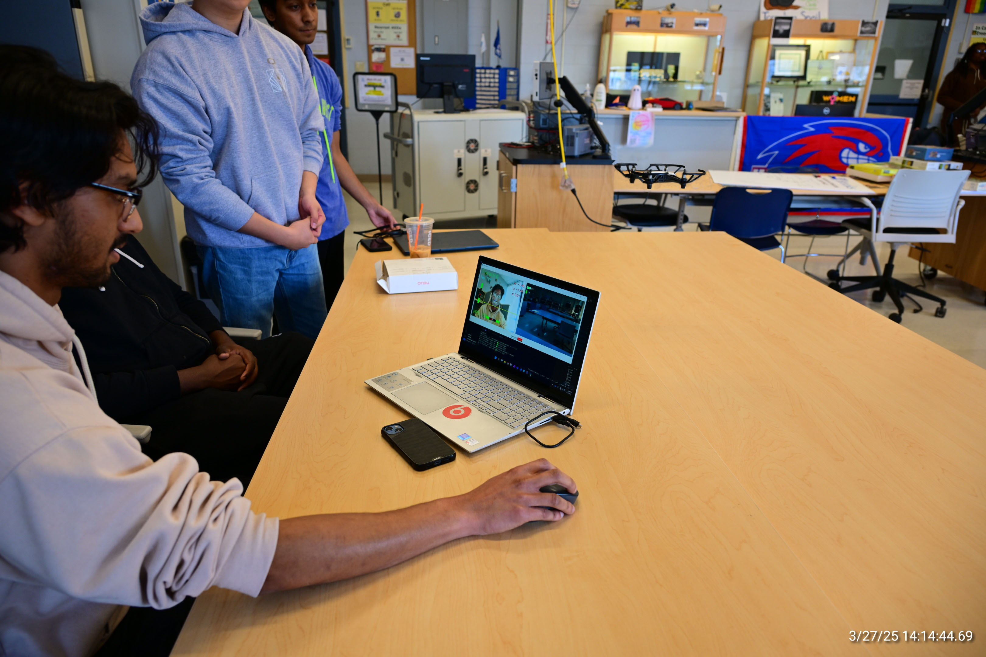
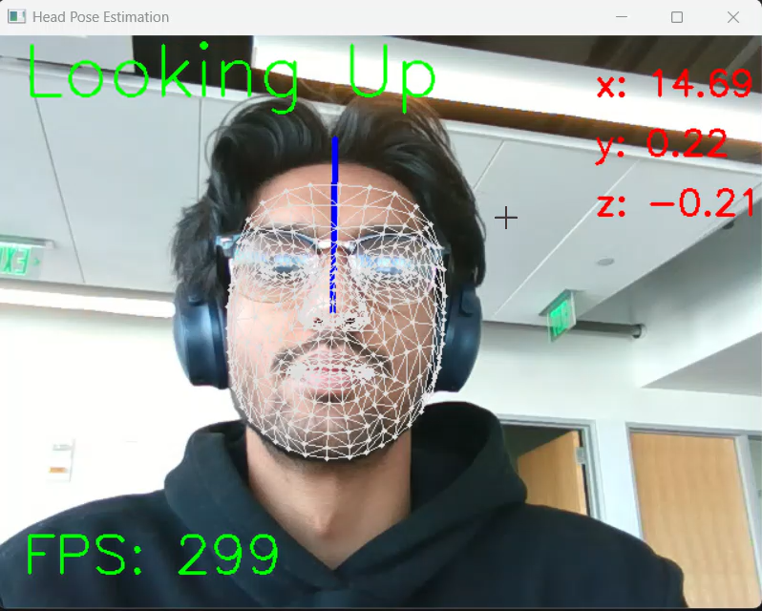
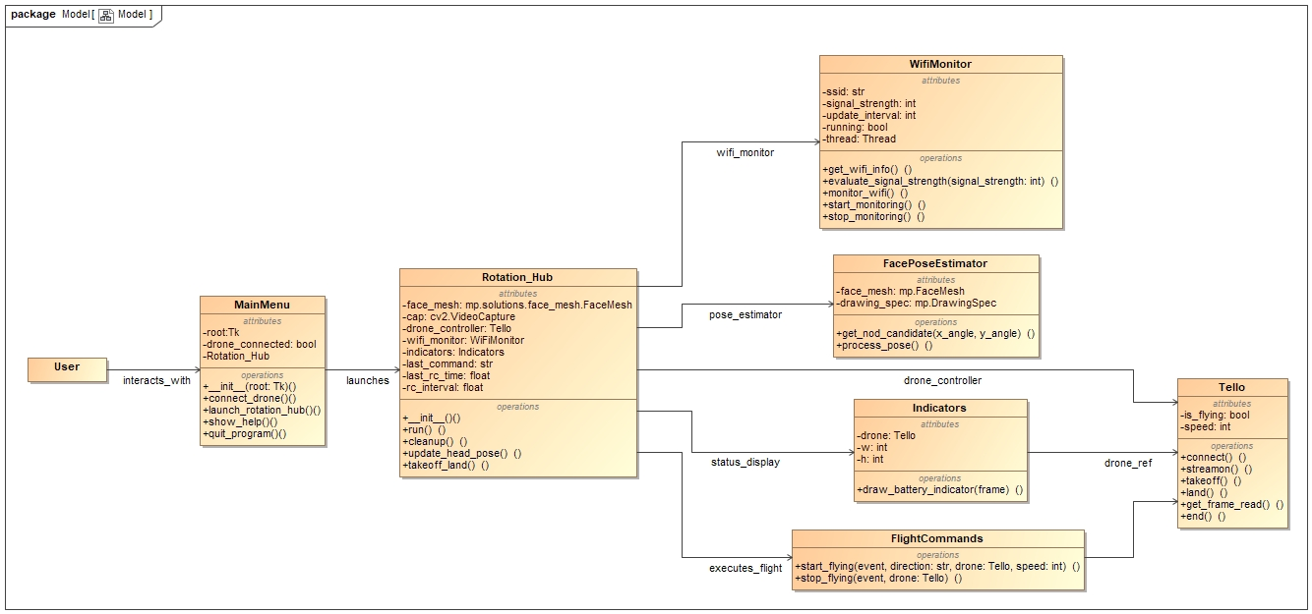
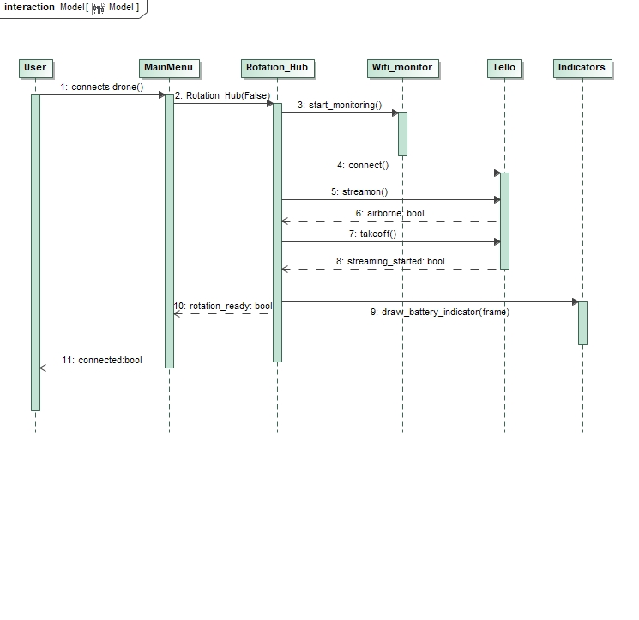
Capstone Project: Adaptive Drone
Sponsor: Seven Hills Term: Fall 2024 / Spring 2025
Himadri Saha (CpE), Abumere Okhihan (CpE), Tejas Patil (EE), Daniel Diep (EE)
Mentor: Prof. Jean-Francois Millithaler (ECE Dept.)
Project Description
Design & Analysis
The Seven Hills foundation is committed to promoting and providing innovative and comprehensive health services to individuals with disabilities and life challenges.
People with physical disabilities such as quadriplegia have difficulties interacting with the environment.
It is desired to have an adaptive photography drone controller that will provide that experience without requiring the use of limbs.
The objective is to create a set of controls for a photography drone that a person with physical disabilities can use by May 2025.
The solution is to design a PC based application using Python that tracks head rotation to pilot a DJI Tello photography drone.
The system will have a GUI that plots points on the user's face to track how the head is moving to determine the certain direction at which the drone will fly.
DJI Tello
Project Overview
Utilizing the DJI Tello’s SDK, a Python program was written that mapped the drone’s control functions to a MediaPipe based head rotation system.
Through the application’s GUI, the user will be able to view the drone FPV and take photos using head movement.
As a safety measure, a kill switch has also been implemented in the GUI for quick termination of the program.
The application will be packaged in an executable file and be ready for use on any Windows OS device alongside an Autodesk Instructables guide by May 2025.
Demo of Application
MediaPipe based Head Rotation System
Class Diagram Displaying Packaging of the Application
Sequence Diagram Displaying User Interaction
Conclusions
Acknowledgements
The team has successfully completed this project, and it will be ready to use at Seven Hills by May 2025!
Some future work may include allowing the next set of students that decide to continue this project to create a universal solution to control any drone with head rotation.
A very big thank you to our mentor: Prof. Jean-Francois Millithaler (ECE).
As well as our sponsor staff: Steven Kessler and Ryan Beckett.
Special thanks to Prof. Alessandro Sabato (ME) and Prof. Maru Cabrera (CS) for their guidance and assistance.

